Slide 1





Wanderlust: a personalized travel planning and tracking app
Presented by Sathish

Slide 2
Description
Wanderlust is an innovative travel companion app that simplifies planning, enhances exploration, and fosters connection. This user-friendly platform tailors travel experiences to individual preferences, ensuring unforgettable adventures.

Slide 3
Java Program
package com.example.travelapp
import android.content.Context
import android.content.Intent
import android.os.Bundle
import androidx.activity.ComponentActivity
import androidx.activity.compose.setContent
import androidx.compose.foundation.Image
import androidx.compose.foundation.clickable
import androidx.compose.foundation.layout.*
import androidx.compose.foundation.rememberScrollState
import androidx.compose.foundation.verticalScroll
import androidx.compose.material.Card
import androidx.compose.material.Text
import androidx.compose.runtime.Composable

Slide 4
import androidx.compose.ui.Alignment
import androidx.compose.ui.Modifier
import androidx.compose.ui.draw.scale
import androidx.compose.ui.graphics.Color
import androidx.compose.ui.res.painterResource
import androidx.compose.ui.res.stringResource
import androidx.compose.ui.text.font.FontFamily
import androidx.compose.ui.text.font.FontWeight
import androidx.compose.ui.text.style.TextAlign
import androidx.compose.ui.unit.dp
import androidx.compose.
ui.unit.sp
class MainActivity : ComponentActivity() {
super.onCreate(savedInstanceState)
setContent {
TravelApp(this)
}
}

Slide 5
@compatible
fun TravelApp(context: Context) {
Column(
modifier = Modifier
.padding(20.dp)
.verticalScroll(rememberScrollState())
) {
Text(
fontSize = 40.sp,
color = Color(android.graphics.Color.rgb(120, 40, 251)),
fontFamily = FontFamily.Cursive,
text = "Wanderlust Travel"
)
Spacer(modifier = Modifie
r.height(20.dp))

Slide 6
//01
Card(
modifier = Modifier
.fillMaxWidth()
.height(250.dp)
.clickable {
context.startActivity(
Intent(context, BaliActivity::class.java)
)
},
elevation = 8.dp
)
{
Column(
horizontalAlignment = Alignment.CenterHorizontally
) {

Slide 7
Image(
painterResource(id = R.drawable.bali), contentDescription = "",
modifier = Modifier
.height(150.dp)
.scale(scaleX = 1.2F, scaleY = 1F)
)
Text(
text = stringResource(id = R.string.place_1),
fontSize = 18.sp
)
Text(
text = stringResource(id = R.string.description),
fontWeight = FontWeight.Light,
fontSize = 16.sp,
textAlign = TextAlign.Center,)

Slide 8
Text(
text = stringResource(id = R.string.plan), color = Color.Gray,
fontSize = 16.sp
)
}
}
Spacer(modifier = Modifier.height(20.dp))
//03
Card(
modifier = Modifier
.fillMaxWidth()
.height(250.dp)
.clickable {
context.startActivity(
Intent(context, SingaporeActivity::class.java)

Slide 9
)
},
elevation = 8.dp
)
{
Column(
horizontalAlignment = Alignment.CenterHorizontally
) {
Image(
painterResource(id = R.drawable.singapore), contentDescription = "",
modifier = Modifier
.height(150.dp)
.scale(scaleX = 1.2F, scaleY = 1F)
)
Text(
text = stringResource(id = R.string.place_3),
text = stringReso
fontSize = 16.sp
)
}
}
Spacer(
modifier = Modifier.height(20.dp))
}
}
}

Slide 10
Text(
text = stringResource(id = R.string.plan), color = Color.Gray,
fontSize = 16.sp
)
}
}
Spacer(modifier = Modifier.height(20.dp))
//03
Card(
modifier = Modifier
.fillMaxWidth()
.height(250.dp)
.clickable {
context.startActivity(
Intent(context, SingaporeActivity::class.java)
)
},
elevation = 8.dp
)
{
Column(
horizontalAlignment = Alignment.CenterHorizontally
) {
Image(
painterResource(id = R.drawable.singapore), contentDescription = "",
modifier = Modifier
.height(150.dp)
.scale(scaleX = 1.2F, scaleY = 1F)
fontSize = 18.sp
)
Text(
text = stringResource(id = R.string.description),
fontWeight = FontWeight.Light,
fontSize = 16.sp,
textAlign = TextAlign.Center,
)
Text(
text = stringResource(id = R.string.plan), color = Color.Gray,
fontSize = 16.sp
)
}
}
Spacer(modifier = Modifier.height(20.dp))
}
}
}

Slide 11
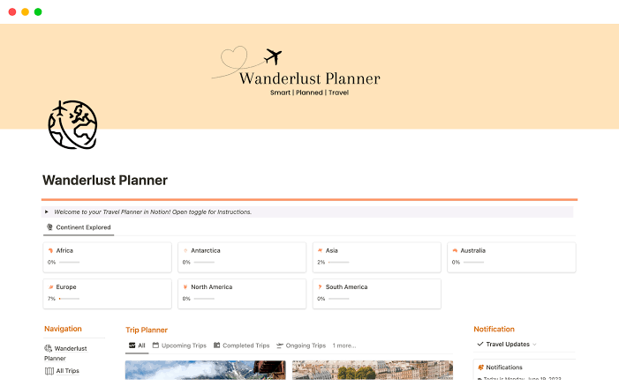
Output :

Slide 12
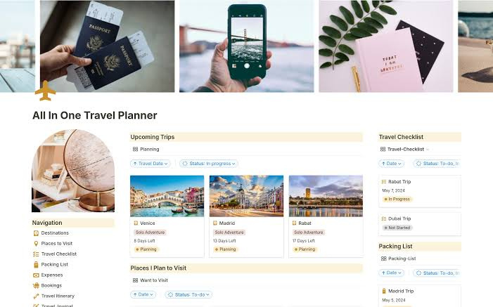

Slide 13
Conclusion :
Wanderlust is a revolutionary travel companion app that simplifies planning, enhances exploration, and fosters connection. By tailoring travel experiences to individual preferences, Wanderlust ensures that every journey is a memorable one. With its user-friendly interface, expert-curated destination guides, and real-time tracking features, Wanderlust is the ultimate travel app for adventurers worldwide.

